Slide 1

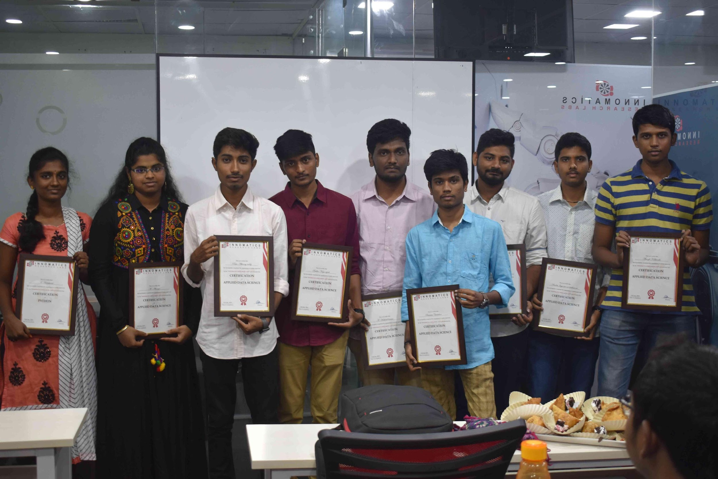
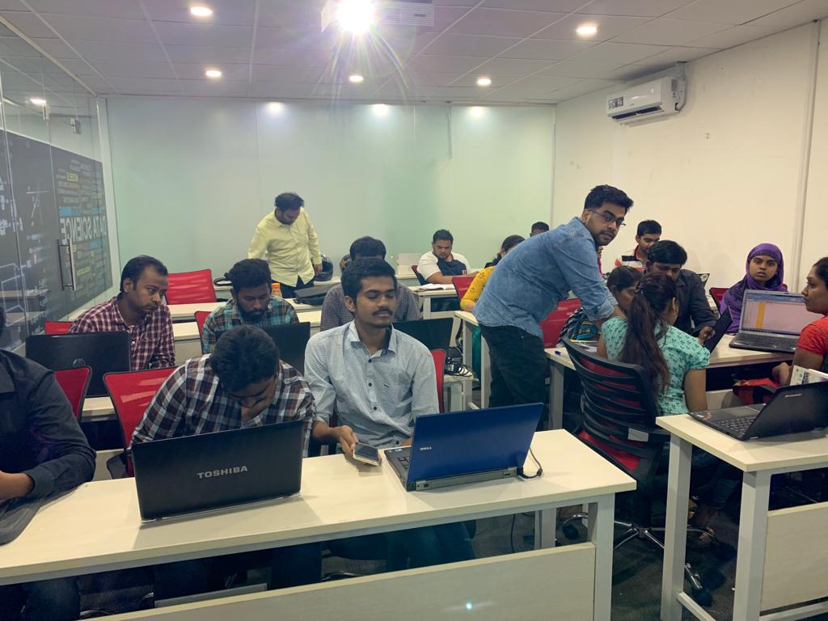

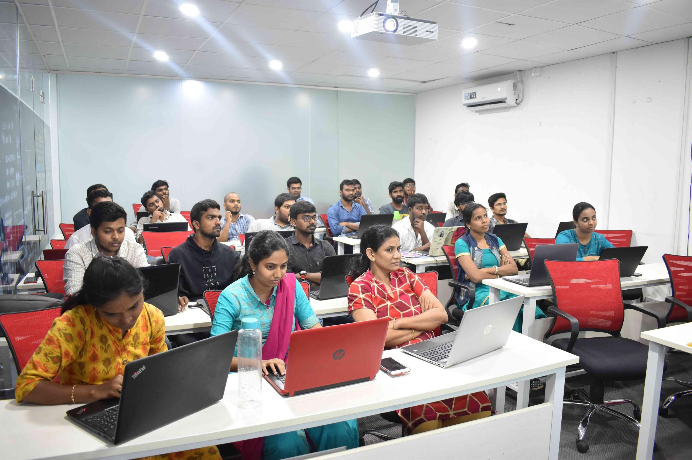



Slide 2
COVID 19 CHATBOT
With RASA

Slide 3
Introduction
Corona virus disease (COVID-19) is an infectious disease caused by the SARS-CoV-2 virus.
Most people infected with the virus will experience mild to moderate respiratory illness and recover without requiring special treatment.
However, some will become seriously ill and require medical attention.
With the recent outbreak of the pandemic, there have been mass panic among the communities.
A chatbot is an artificial intelligence (AI) software that can simulate a conversation (or a chat) with a user in natural language through messaging applications, websites, mobile apps or through the telephone.
A Chatbot can help us automate the regular responses to general queries, eliminating the need of human intervention.
Although a human help can be provided when required.

Slide 4
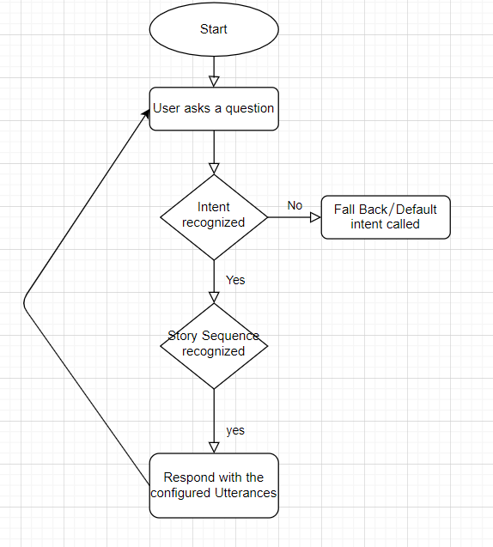
RASA Framework
Rasa is an open-source machine learning framework for building AI assistants and chatbots. Rasa has two main modules:
NLU for understanding user messages,
Core for holding conversations and deciding what to do next.

Slide 5
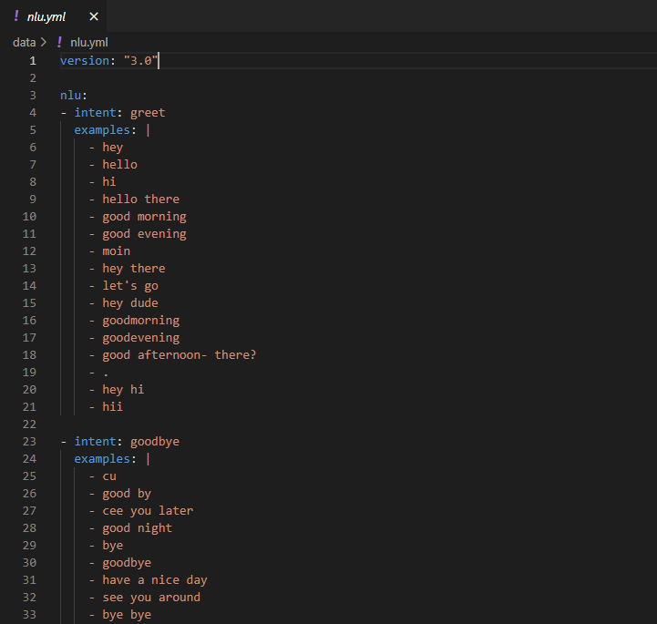
Intents

Slide 6
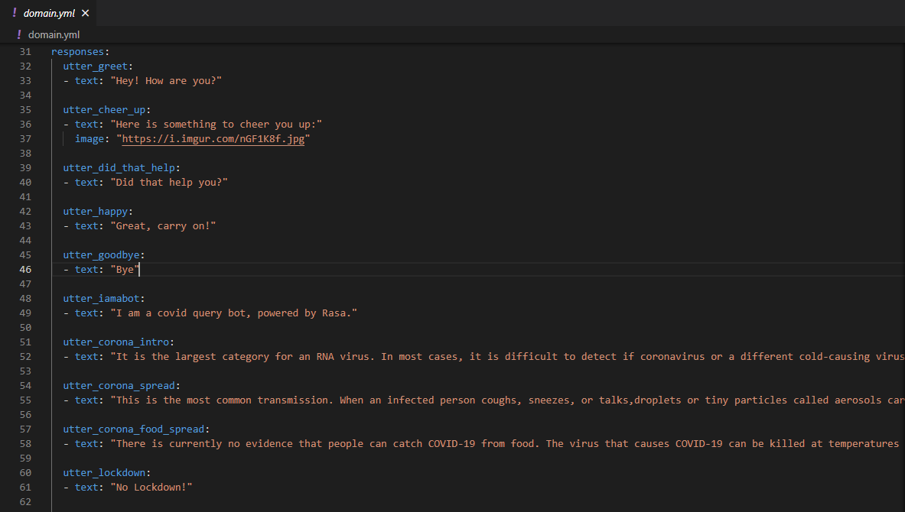
Responses

Slide 7
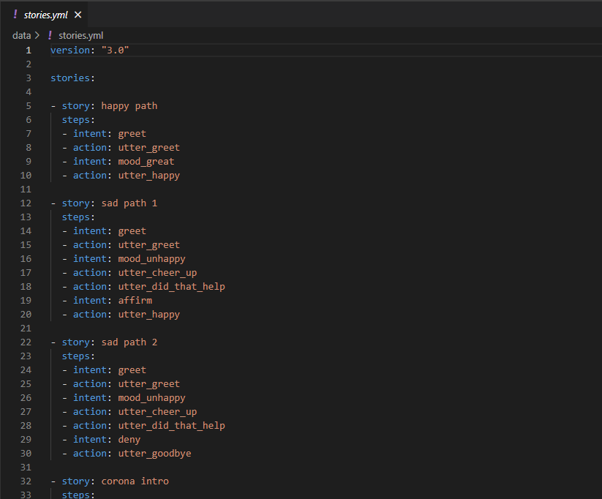
Stories

Slide 8
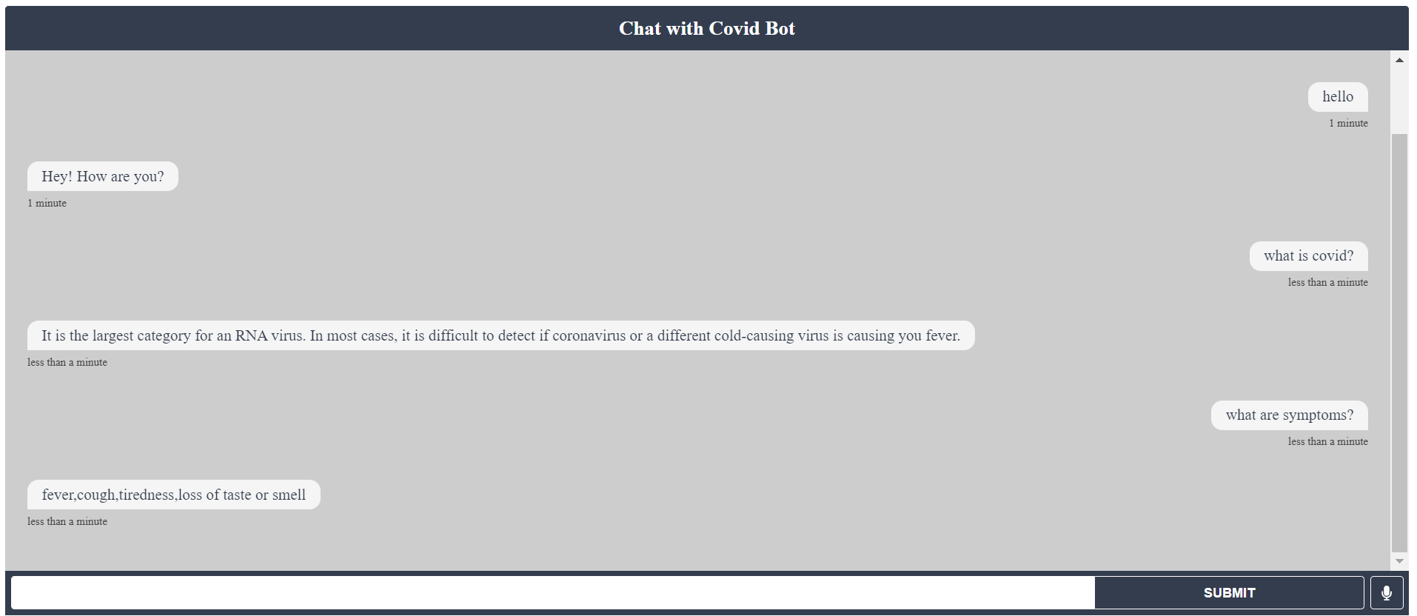
Working

Slide 9
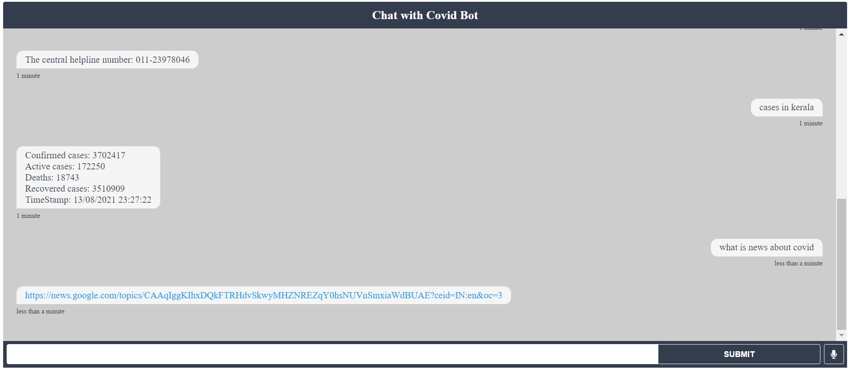
Working

Slide 10

THANK YOU

